Slide 1
CSCNSI 2015
Linux Introduction

Slide 2
Introduction
Linux Operating Systems
The Shell
Text Editors
Basic Commands
File System
System Logs

Slide 3
Linux Operating System

Slide 4
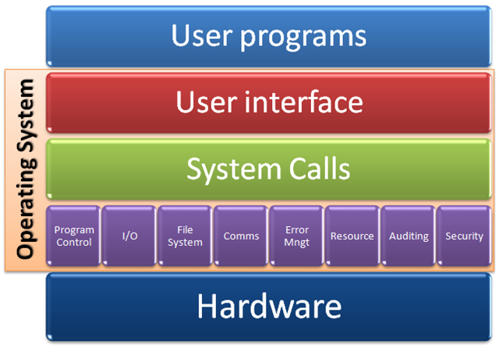
Operating Systems
The middle layer between programs and the hardware
http://i.stack.imgur.com/swJir.png

Slide 5
Linux

Slide 6
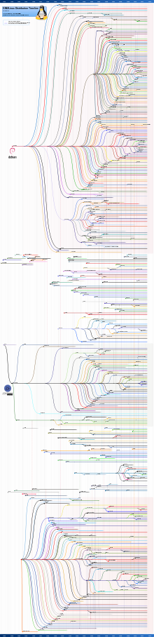
Linux
Unix-like OS
Mainly open source
Many “flavors”
Red Hat variants
Debian variants
Slackware variants
Etc

Slide 7
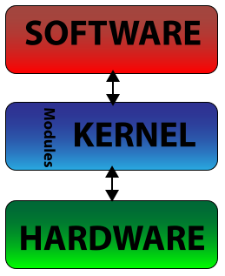
Operating Systems Features
Linux Kernel
Management software
Package management
Filesystem types
ext2/3/4, btrfs, etc
Graphical user interface
Gnome, KDE, Xfce, etc
Security (i.e. selinux)

Slide 8
The Shell

Slide 9
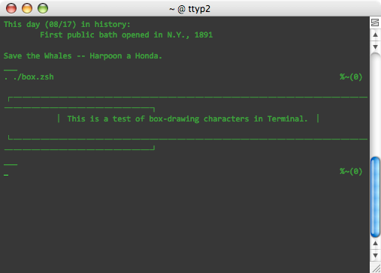
The Shell
User Interface to the OS
Terminal vs. Shell
Many linux CLI shells
Bourne Shell (sh)
Bourne Again Shell (bash)
C Shell (csh)
Etc

Slide 10
The Linux Shell (specifically BASH)
Command Processor
Command history
Command and path autocompletion
Command aliases
Pattern matching
Variable substitution
Piping, I/O redirection
Startup scripts

Slide 11
Text Editors

Slide 12
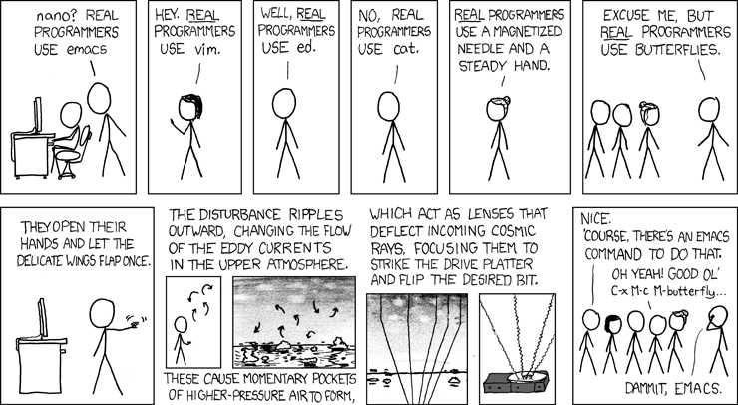
The Editor War

Slide 13
Text Editors
CLI
vi, vim
emacs
nano
GUI
gvim
gedit (GNOME)
kate (KDE)

Slide 14
Basic Commands

Slide 15
Basic Commands
Help
Looking for help:
man [section] command
man -k search
command --help

Slide 16
Basic Commands
General
ls # list directory contents
cd # change directory
pwd # current directory
cat # print contents of file
echo # print text to screen
shutdown # system shutdown or reboot
exit # exit the session
who # list logged in users
wall message # print message to all

Slide 17
Basic Commands
History
history # list command history
!num # execute command number
<up arrow> # scroll up history
<down arrow> # scroll down history
<ctrl><r> # searches history

Slide 18
Basic Commands
Shortcuts
<shift><page up> # scroll up
<shift><page down> # scroll down
<ctrl><alt><f#> # change terminal
<ctrl><c> # kill process

Slide 19
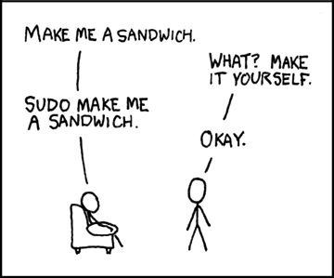
Root User
Run a command as another user
su [-] [username] [-c command]
Requires other password
sudo [-u username]
Requires your password
Config file: /etc/sudoers

Slide 20
User Management
Create a new user:
useradd username
passwd [username]
Configuration files:
/etc/passwd
/etc/shadow
/etc/group
/etc/gshadow

Slide 21
Basic Commands
Package Management
Red Hat’s package manager:
yum [-y] [search|list|install|update|...]
Works with package repositories:
/etc/yum.repos.d/

Slide 22
Basic Commands
User Permissions
Change Mode
chmod [ugo] [-+=] [rwxX]
Change Owner
chown user[:group] | uid[:gid]
Change Group
chgrp group|gid

Slide 23
Basic Commands
Text Files
File Contents:
cat # prints contents of file
less # scrollable file contents
tail # prints last part of file
head # prints first part of file

Slide 24
Basic Commands
Pattern Matching
Pattern Matching:
grep [-R] [-I] [-i] [-o] pattern [filename]
sed [i] pattern [filename]
awk pattern { action }

Slide 25
Basic Commands
Process and Job Control
Process and signal control:
ps [aux] # list processes
top # interactive process list
kill [-9] pid # kill process
nohup command # run command immune to hangup signal

Slide 26
Basic Commands
Process and Job Control
Job control:
command & # execute in background
<ctrl><z> # suspend process
jobs # list running jobs
bg [jobnum] # sends job to background
fg [jobnum] # sends job to foreground

Slide 27
Basic Commands
System Services
System service control:
service service [start|stop|status|restart]
System service runlevel control:
chkconfig --list
chkconfig [--level nums] service [on|off]

Slide 28
Basic Commands
Network
Common network commands:
service network restart
ifconfig [dev]
ping [address]

Slide 29

Basic Commands
SELinux
You will run into problems with SELinux
For this course, disable it
getenforce
setenforce 0
change SELINUX to =disabled in /etc/selinux/config

Slide 30
File System

Slide 31
File System Layout
/ #root directory
/bin, /sbin, /lib #binaries and libraries
/boot #startup files and the kernel
/dev #device access
/etc #system configuration
/home #home directories
/initrd #boot information
/mnt #mound point for external FS

Slide 32
File System Layout
/var #variable files, log files
/opt # extra, 3rd party software
/proc # virtual FS containing system info
/root # root’s home directory
/usr # things for user-related programs
/tmp #temporary space, cleaned on reboot

Slide 33

File System
/sys/
Virtual file system called sysfs
Access to kernel objects
busses (USB; PCI; etc)
devices
drivers
http://kernel.org/doc/Documentation/filesystems/sysfs.txt

Slide 34
File System
/dev/
Access to devices
Drives (CD/DVD, USB, SCSI)
Ports (serial, parallel, joystick)
Access to streams
/dev/stdout, /dev/stderr, /dev/stdin
Other stuff
/dev/null, /dev/zero, /dev/urandom

Slide 35
System Logs

Slide 36
System Logs
Most logs are located in /var/log/
Most common CentOS log files
/var/log/messages
/var/log/secure

Slide 37
Summary

Slide 38
Summary
Operating Systems
Linux
The Shell
Text Editors
Basic Commands
File System
System Logs

Slide 39
More Information
The Linux Documentation Project
http://tldp.org
Linux From Scratch
http://linuxfromscratch.org
GNU Toolchain
http://gnu.org

